Slide 1
Intro to Design Patterns
Lecture 6.1 – Final

Slide 2
A Simulation of an Injection Molding Facility
Design and implement solution with design patterns to specs
Two weeks (~1,000 lines of code)
Process an input file of 5 orders
An output file showing the processing of the orders
Given new specs in class, add code to implement them
A new input file, the original 5 orders plus 4 new ones
An example output file, diff with output of new program
Grade – email source code file to instructor (allan.d.goff@intel.com)
1 hour – A
2 hours – B
3 hours – C
4 hours – D

Slide 3
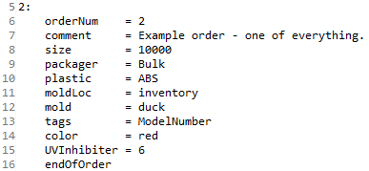
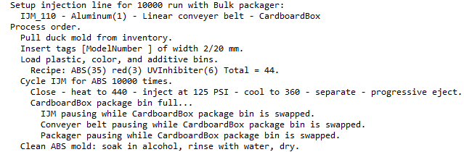
Example Order/Output
Assume data base has added elements to the customers’ orders to make our code simpler

Slide 4
Problem Domain: Metals
Injection molding machines use a two part mold
Aluminum – good for 10,000 runs
Cheaper and faster to mill
Less time to heat and cool, higher throughput
Wears out 5 times faster
Stainless steel – good for 50,000 runs
Expensive
Slower to mill
Takes longer to heat and cool, lower throughput
Lasts 5 times longer
Molds have one to a few cavities, typically all of the same shape.
Size of order typically decides choice of metal and number of cavities

Slide 5
Problem Domain: Injection Process
Repetitive process
Close mold
Mix plastic, color, and any additives
Heat mold to temperature depending on plastic type
Inject mix at specified PSI depending on plastic type
Cool mold to temperature depending on plastic type
Open mold
Eject part, technique may also depend on plastic type
Progressive
Smooth
What’s changing?
The injection and ejection processes
Strategy
Notes:
Strategy pattern - 1

Slide 6
Problem Domain: Mold Location
Inventory
Fetch from inventory
Mill
Mill from stock blocks
Shapes created by drill, cut, & grind operations
What’s changing?
Where the mold comes from
Notes:
Chain of Responsibility pattern - 8

Slide 7
Problem Domain: Shapes
Cavity shape determines the part the mold makes (think plastic toy)
Duck (35 cc)
Car (40 cc)
Hero (50 cc)
Mill
Shapes created by drill, cut, & grind operations specific to each shape
Aluminum block – mill with High Carbon tools
Steel block – mill with Carbide tools
Finishes
Smooth
Rippled
What’s changing?
Shape and tools
Bridge
Notes:
Bridge pattern - 9

Slide 8
Problem Domain: Tags
Tags: mark part with things like model number or country made in
Typically grouped together in a flat place on the part (under base)
Total width (20 mm) and breadth fixed
Each tag has a specified width (mm) and the same breadth
Original specs
Blank (set of, with different widths)
Model number (2 mm)
Country (2 mm)
Date (2 mm)
What’s changing?
Which tags get inserted into the mold
decorator
Notes:
Decorator pattern - 6

Slide 9
Problem Domain: Domains (x-axis)
Plastic
ABS
Polypropylene
Polyethelene
PET
Colors (vol = 10% of shape)
black
brown
red
orange
yellow
green

Slide 10
Problem Domain: Plastics & Additives
Additives – enhance product performance
UV inhibiters (product degrades less in sunlight)
Antibacterial (product less likely to be a disease vector)
For simplicity we’ll assume that the color dies and additives don’t depend on the plastic type
What’s changing?
Which additives get mixed in with the base plastic and color dies
Decorator
Notes:
Decorator pattern - 6

Slide 11
Problem Domain: Machines
Machines vary by mold metal and how many cavities they can handle
IJM_110: Aluminum, 1 cavity – 10,000 parts
IJM_120: Aluminum, 2 cavities – 20,000 parts
IJM_210: Steel, 1 cavity – 50,000 parts
Depends on run size
Abstract Factory

Slide 12
Problem Domain: Post Eject
Conveyer belt
Linear – suitable for small orders
Y-Split – suitable for larger orders
Depends on run size

Slide 13
Problem Domain: Post Eject
Package bin (output bin)
Cardboard box – suitable for small orders
Pallot box – suitable for larger orders
Depends on run size
When full, must tell IJM, conveyer belt, and Packager to pause so it can be swapped out with an empty bin
What’s changing?
Machines that need to pause when package bin is full
Observer
Notes:
Observer pattern - 7

Slide 14
Problem Domain: Post Eject
Packager
Bulk, simply dump part into the output bin
Shrink wrap, wrap each part in plastic, heat to shrink
Hard pack, each part placed into preformed plastic case
What’s changing?
The class of the machine that packages the parts
Factory Method
Notes:
Factory Method pattern - 5

Slide 15
Problem Domain: The Injection Line
Sequence of Machines
IJM
Mold (shape, metal, cavities)
Conveyer belt
Output bin
Driven by size of order
10,000
20,000
50,000
What’s changing
The set of specific machines that form the injection line
Chain of responsibility
Notes:
Abstract Factory pattern - 10

Slide 16
Problem Domain: Cleaning
Cleaning the molds – depends on plastic and metal
ABS – soak in alcohol, rinse with water, dry
Use legacy method clean()
Polypropylene/Polyethelene – rinse with acetone, dry
Use legacy method prepForReuse()
PET
Aluminum – rinse with soap and water, dry
Use legacy method purify()
Steel – carbonize (heat to 895 C)
Use legacy method carbonize()
Note: the above are largely made up ;)
What’s changing?
The specific methods that have to be called
Adapter
Notes:
Adapter pattern - 2

Slide 17
Problem Domain: The Injection Run
Setup the injection line
IJM
Mold
Conveyer belt
Packager
Output bin
Get and install the mold
Insert tags into mold
Load additive bins
Run the injection cycle till done
Clean the mold
What’s changing
The processing steps
Template Method
Notes:
Template Method pattern - 4

Slide 18
Code
Reads input file of orders
Specifics are name value pairs (key = value)
Grouped into orders and placed into a map<string, string> order
Probably don’t want to change the input code
demo()
parse()
getCompleteOrder()
Legacy namespace
Do not change this code
It is there to simulate the code that in the wild we can’t change but must use nonetheless

Slide 19
Code Cont.
Recommended main()
#include finalDesign.h
#include finalProblem.h
#include finalSolution.h
int main(int argc, char* args[]) {
string orderFile(args[++i]);
final_design_file::demo(orderFile)
final_problem_file ::demo(orderFile)
final_solution_file::demo(orderFile)
} // Comment out lines above per what step you are on.
Note, you may need to explicitly include standard C/C++ headers

Slide 20
Code Cont.
Note: many of the classes have names that indicate which design pattern is in use
Sometimes it is the full name (Strategy, Subject, Observer)
Often it is just an abbreviation (like FM for Factory Method)
Often it is suffixed with a number (TM_4)
The number is just the sequence order in which the design patterns were presented in class (made it easier for me to insure final gave good coverage of the subject)
Dtors have been instrumented and grouped altogether into lines
Their diagnostic output always starts with ‘~’
If your diagnostics vary, diffing the output files will vary here

Slide 21
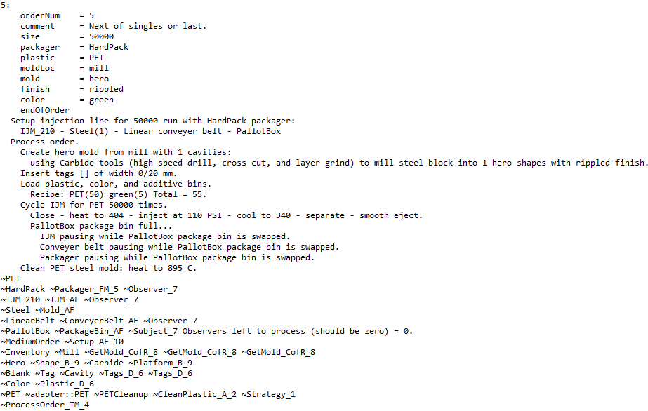
Code Dtor Diagnostics

Slide 22
Execution Suggestions
> finalDesign orders_1.txt > design1.out
> finalProblem orders_1.txt > problem1.out
diff design1.out problem1.out
Diffs should reduce as you implement each new spec
finalProblem orders_2.txt > problem2.out
finalSolution orders_2.txt > solution2.out
diff solution2.out solution2Base.out
Diffs should reduce as you implement each new spec
When the diff is zero, you are done

Slide 23
Design Patterns Used in Final
If the algorithms are varying
If the interfaces are varying
If the API’s are varying
If the steps are varying
If the classes are varying
If the options are varying
If the listeners are varying
If the responders are varying
If abstract’n & implement’n vary
If the families are varying
Use the Strategy pattern
Use the Adapter pattern
Use the Facade pattern
Use the Template Method pattern
Use the Factory Method pattern
Use the Decorator pattern
Use the Observer pattern
Use Chain of Responsibility pattern
Use the Bridge pattern
Use the Abstract Factory pattern

Slide 24
Day of Final (12:55)
Formal spec doc “newSpecsDoc.txt” posted to Inside Blue (15)
New spec file “newSpecs.txt” posted to Inside Blue
Includes original specs, “…” separates original specs from new
Item by item basis
New orders file “orders_2.txt” posted to Inside Blue
Original 5
Plus 4 more which use all the new specs
Your designed solution should run to completion on the new orders file
Baseline solution file “solution2Base.out” posted to Inside Blue
Email your solution source file to allan.d.goff@intel.com

Slide 25
Today
Posted to Inside Blue
finalDesign.h
orders_1.txt
originalSpecs.txt (informal specs, may make seeing what is varying easier)
originalSpecsDoc.txt (Formal specs)
design1.out (double check that boiler plate code is working)
problem1.out (target output file for original specs)
I pulled about 230 lines out of finalSolution.h to create finalProblem.h
Code continued to run w/o crashing with each set of pulled lines
It took me just over an hour to add the code for the new specs

Slide 26
Backup Slides

Slide 27
Problem Domain
Injection molding machines use a two part mold
Aluminum – good for 10,000 runs
Stainless steel – good for 50,000 runs

Slide 28
Problem Domain: Cavities
Molds
Multiple cavities, typically of the same shape
1
2

Slide 29
Problem Domain: Mill
Mill
Shapes created by drill, cut, & grind operations specific to each shape
Aluminum block – mill with High Carbon tools
Steel block – mill with Carbide tools
Finishes
Smooth
Rippled
Notes:
Chain of Responsibility

Slide 30
Problem Domain: Color
Colors
brown
red
orange
yellow
green

Slide 31
Problem Domain: Plastics & Additives
Plastic
ABS
Polypropylene
Polyethelene
PET
Additives – enhance product performance
UV inhibiters (product degrades less in sunlight)
Antibacterial (product less likely to be a disease vector)
For simplicity we’ll assume that the color dies and additives don’t depend on the plastic type

Slide 32
